Slide 1
Effective Cross-cultural leadership
Cdr Vijay Pratap Singh,
Adjunct Professor, E&TC, TCET

Slide 2

Effective Cross-cultural Leadership
Intro Theories Findings Limitations Conclusions
Agenda
Introduction
Theory
Transformational Leadership (TL) Emotional Intelligence (EQ) Cross-cultural Intelligence (CQ) Cultural Awareness
Cultural Adaptation
Effectiveness Management Localization Theories
Research
Conclusion Recommendation References
Q&A
Findings
Limitations
Conclusion
Presented by Cultural Consulting Group:  Prime Elsa  Hoang Bich Ngoc  Pham Hoang Duc

Slide 3


Intro Theories Findings
Transformational Leadership Emotional Intelligence
Transformational Leadership (TL)
Limitations Conclusions
Cross-cultural Intelligence
Occurs when leader engages in a way
Leaders & followers raise one another to higher levels of motivation and morality (Burns, 1978)
Achieve higher performance
TL’s components
•
Inspirational Motivation
Idealized consideration
Individualized Consideration pay attention to others needs
Leader provides vision, motivates others by positive future
http://www.youtube.com/watch?v=6_WAmt3cMdk

Slide 4

Intro Theories
Transformational Leadership
Findings
Limitations Conclusions
Cross-cultural Intelligence
Emotional Intelligence
Emotional Intelligence
The capacity for recognising our own feelings and those of others,
for motivating ourselves, and for managing emotions well in
ourselves and in others. (Daniel Goleman, 1995)
EQ and Effective Leadership
Leadership involves interaction between leader and others
Emotional awareness and Emotional Regulation become important
EQ Competencies
Self-awareness: ability to understand feelings and accurate self-assessment
Self-management: ability to manage internal states, impulses & resources
Social awareness: ability to read people and groups accurately
Relationship-management: ability to induce desirable responses in others
“Emotional intelligence may be meaningful in once cultural setting but inapplicable in another” (Thomas, 2006)

Slide 5

Intro Theories
Transformational Leadership
Findings
Limitations Conclusions
Cross-cultural Intelligence
Emotional Intelligence
Cultural Intelligence
capability for successful adaption to new cultural settings (Earley &
Ang 2003,p.9)
CQ Competencies
Cultural awareness: ability to understand a new culture
Cultural adaptation: capability to change behavior appropriate to the culture
Effective localization management: applying cultural knowledge and adaptation to business environment
Seek for localization balance
Encourage local manager’s commitment Create an open working environment

Slide 6
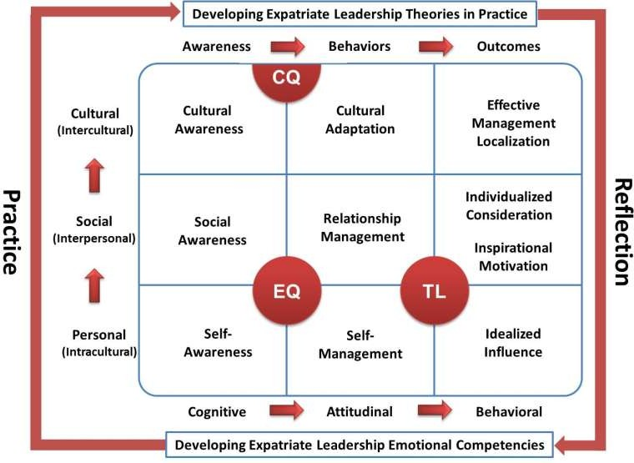
Developing Expatriate Leadership Effectiveness in China
Intro Theories Findings Limitations Conclusions
Source: Deng & Gibson (2009)

Slide 7




Intro
Theories
Findings
Limitations
Conclusions
Interviewees Information
Isidor Subotic
Executive Vice President Project Development
Phan Nam Tran
HR Director of Unilever
Vietnam
Nicot-Bérenger
General Manager of South East Asia Shipyard (SEAS)
J.T.Kim
General Director of Tae Kwang Vina Ltd.

Slide 8


Intro
Theories
Findings
Limitations Conclusions
Effective Management Localization
Cultural Awareness Cultural Adaptation
Lack of understanding lead to conflicts and issues (Mr. Kim)
Training and guidelines help manager be aware on the culture (Ms. Phan Nam Tran)
Managing is the same everywhere but need to know how locals are doing things (Mr. Subotic)
Source: http://www.crossculturalcomm.com/ Source: http://www.actioncoach.com/Effective-Leadership?pressid=478
Tools: - “You cannot stay totally apart from the culture” (Mr. Nicot-Bérenger)
- Trainings (Mr. Kim and Ms. Phan Nam Tran)
Research mostly support the theory

Slide 9
Intro
Theories
Findings
Limitations Conclusions
Effective Management Localization
Cultural Awareness
Cultural Adaptation
“The most important is mutual understanding and mutual trust.” (Mr. Kim)
 | Mr. Subotic | Mr. Kim | Ms. Phan Nam Tran | Mr. Nicot- Bérenger
Leader’s adaptation | No | Yes | Corporate culture and mutual adaptation | Yes but Stick to corporate culture
Followers adaptation | Management style and corporate culture | N/A |  | Leadership style and corporate culture
Support the theory except for Mr. Subotic
Gap: followers' adaptation + corporate culture

Slide 10
Intro
Theories
Findings
Limitations Conclusions
Effective Management Localization
Cultural Awareness
Cultural Adaptation
 | Seek Localization Balance | Encourage Local Manager’s Commitment to the Company | Create An Open Working Environment
Mr. Subotic | YES | YES | YES
Mr. Kim | NO | YES | YES
Ms. Phan Nam Tran | YES | YES | YES
Mr. Nicot-Bérenger | YES | YES | YES
Seek for localization balance
Imbalance in management level
Cost is also a consideration in recruitement
Encourage local manager’s commitment to the company
Create open working environment

Slide 11


Intro
Theories
Findings
Limitations Conclusions
Research’s Limitation
Theories’ Limitation
Qualitative
Subjectivity
Focus on Australia and China
Overlook corporate culture and followers’ adaptation
Source: http://www.shutterstock.com/
11

Slide 12
Intro
Theories
Findings
Limitations Conclusions
Research’s Limitation
Theories’ Limitation
Focus on CQ
Subjectivity
Lack of representativeness
Source: http://www.shutterstock.com/
12

Slide 13



Intro
Theories Findings Limitations Conclusions
Recommendations References Q&A
Conclusion
TL & EQ are important in any situation
CQ is important when it comes to cross-cultural context
Gaps found between theory and reality: corporate culture is more important and it supports TL, EQ and CQ
Source: http://www.opereationpayoff.com
Source: http://www.prinpink.wordpress.com
13

Slide 14
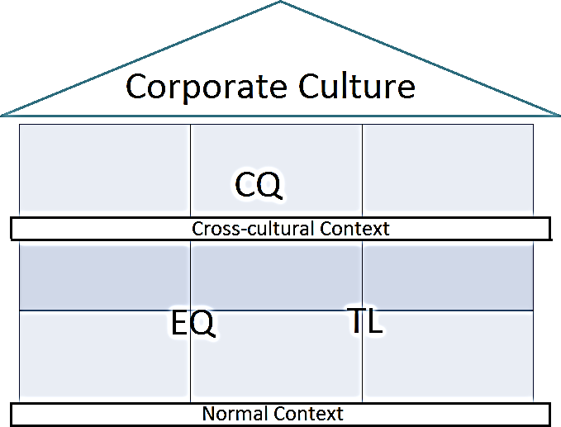
Intro
Theories Findings Limitations
Recommendations References
Adjusted model
Conclusions
Conclusion
Q&A
14

Slide 15
Intro
Theories Findings Limitations Conclusions
Recommendations References Q&A
Conclusion
Deng, L. and Gibson, P. (2009), Mapping and modelling the capacities that underlie effective cross-cultural leadership - An interpretive study with practical outcomes, Cross Cultural Management: An International Journal, Vol. 16 No. 4, p. 347-366
Deng, L. (2008), EQ and CQ of Expatriate Transformational Leaders: a qualitative study of cross-cultural leadership effectiveness for Australian business managers working in China, RMIT University
Burns, J.M. (1978), Leadership, Harper and Row, New York, NY.
Hofstede’s website: http://geert-hofstede.com/
HSBC’s video source: https://www.youtube.com/watch?v=WcEfzHB08QE, accessed on 07.04.2012
1St image’s source: http://www.crossculturalcomm.com/, accessed on 05.04.2012
2nd image’s source: http://www.actioncoach.com/Effective-Leadership?pressid=478, accessed on 05.04.2012
Video: http://www.youtube.com/watch?v=6_WAmt3cMdk 09-04-2012
Interview of Mr. Subotic, 2012
Interview of Mr. Kim, 2012
Interview of Ms. Phan Nam Tran, 2012
Interview of Mr. Nicot-Bérenger
15

